Slide 1
Good-Bot Data 515

Slide 2
Synopsis of Good-Bot
Ruthless-Raven/Good-Bot (github.com)
Good-Bot is an interactive Python module that assists users in analyzing text documents
Simulates human conversations and works independently from a human operator
User request analysis/ returning a response

Slide 3
Targeted Users
Business leaders looking to automate website support and reduce customer service costs
Product Managers who wants to implement a chatbot to automate the collection of customer feedback
Github community to optimize and add more functionality to Good-Bot

Slide 4
Purpose
Good-Bot helps add convenience for users
Automated program that interacts with customers like a human would and cost little to nothing to engage with
Improve user engagement process and operational efficiency

Slide 5
Structure
ReadMe File
Requirements
Setup.py
Good-Bot.py
Test Folder
Example Folder

Slide 6
Project Comparison
ChatBot-for-Sentiment-Analysis/ChatBot using AI.py at master · tripathi-abhishek/ChatBot-for-Sentiment-Analysis (github.com)
Sentiment Analysis
Uses TextBlob Python Library for processing textual data

Slide 7
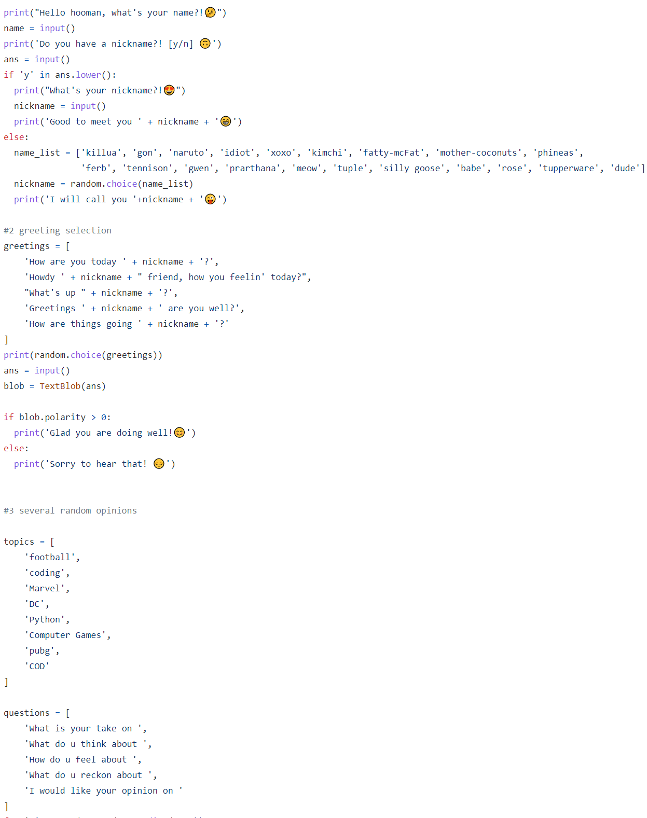
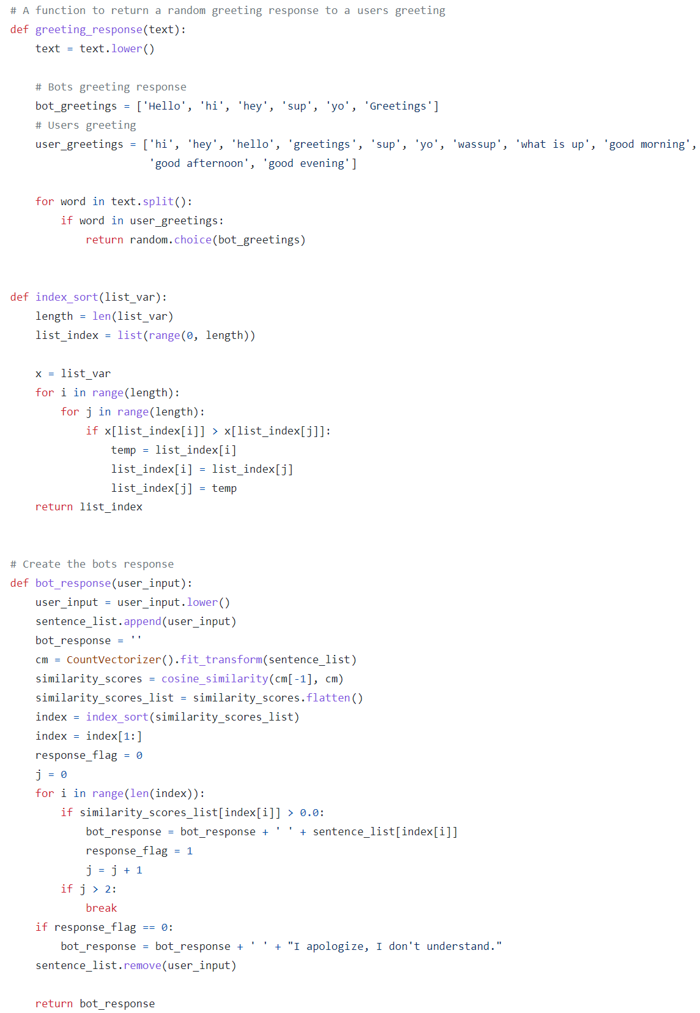
Design Decisions
Procedural Code vs Functional

Slide 8
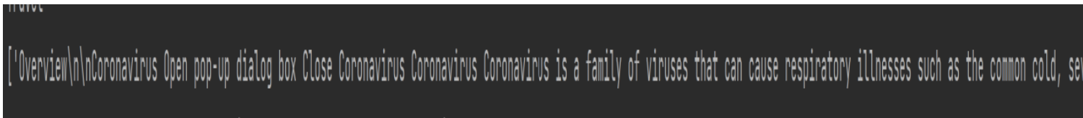
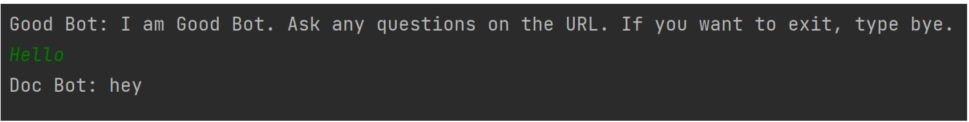
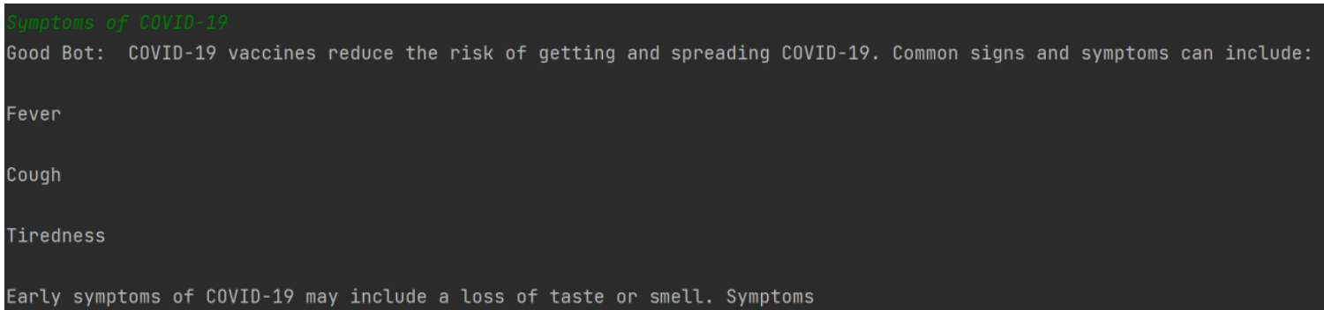
Software Usage
Good-Bot reads URL
Text is parsed and sentences separated
Good-Bot prompts user to ask a question
Good-Bot outputs the answer to the users question

Slide 9
Future Work
JSON API training data to expand Good-Bot functionality and abstraction
Implement deep learning and a neural network software using TensorFlow
Create classes to prevent data leakage and accessibility

